Slide 1
Closing the Diversity Gap in Human Genomics
Ubiquitous Genomics Ashley Newman
10/06/2022
A proposal for a social impact start-up

Slide 2
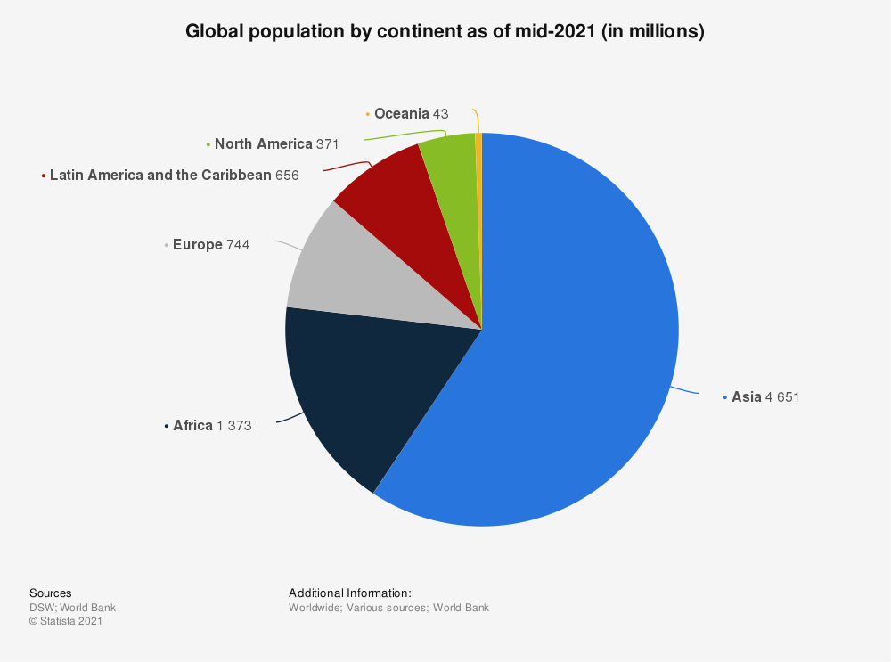
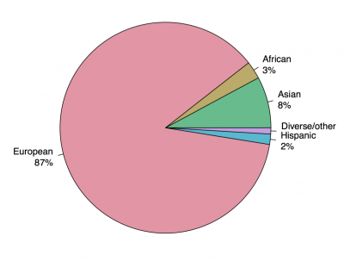
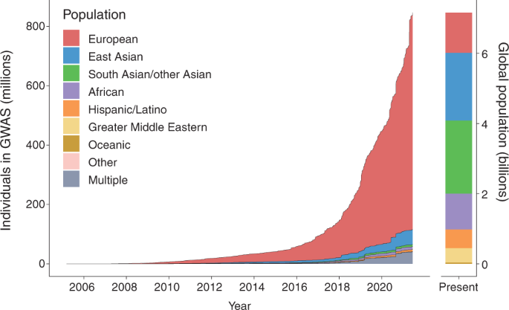
Ancestry Groups in genome-wide association studies (GWAS) 2019
Despite being a critical aspect of drug discovery and health research, most participants of genomic studies have been of European descent
Sources:
https://www.statista.com/statistics/262881/global-population-by-continent/
https://www.ucl.ac.uk/lifesciences-faculty/news/2019/oct/importance-diversity-genomics-research
https://www.nature.com/articles/s41591-021-01672-4
Notes:
With the beginning of the Genome-Wide Association Studies in 2007, many of the available samples were of Norther European descent. Although some gains have been made in terms of large samples from all across Europe and East Asia, unfortunately the majority of genome-wide association study samples were still of European descent as of early 2022.

Slide 3
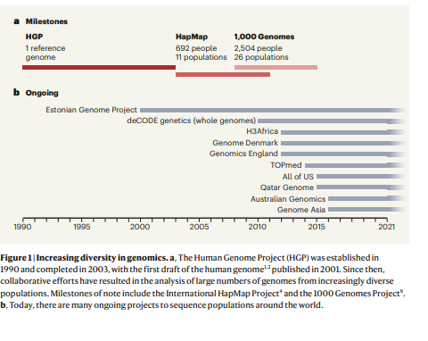
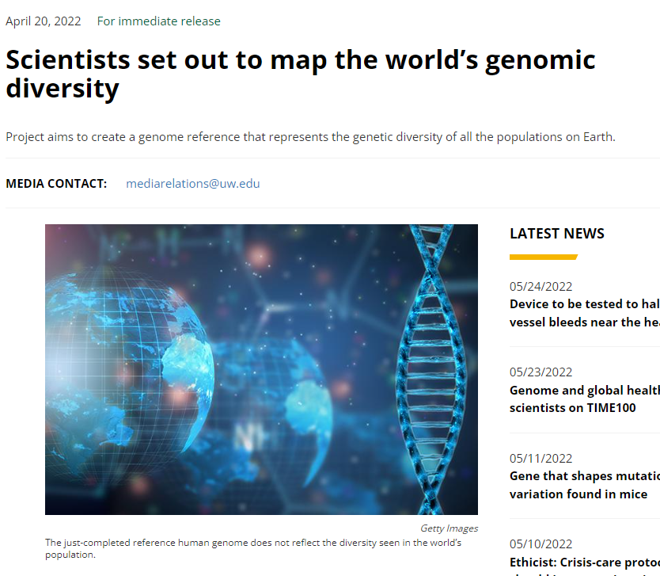
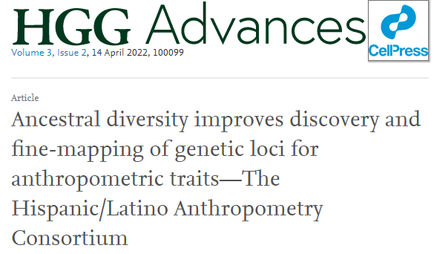
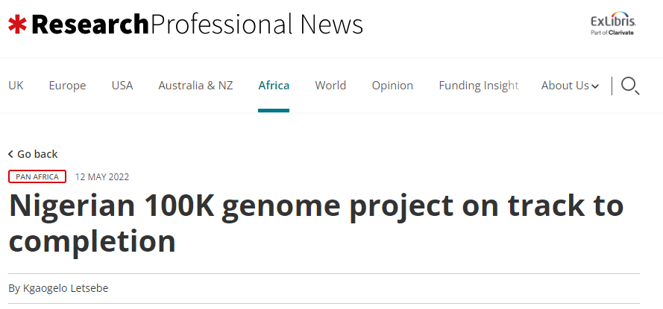
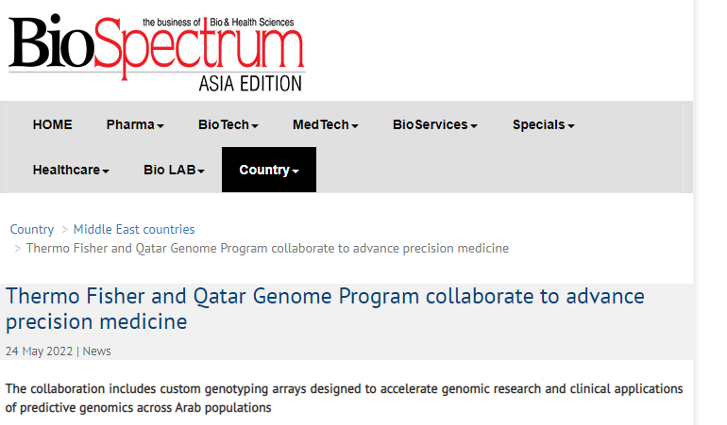

Notes:
An international consortium of scientists has launched a new effort to create a reference genome that captures the genetic diversity of all the peoples of the world. The researchers describe the initiative, called the Human Pangenome Project. The effort is funded by the U.S. National Human Genome Research Institute and National Institutes of Health. 2022

Slide 4
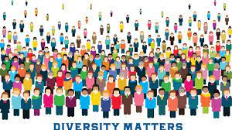
Why it’s important for research
Knowing how genomic variants vary by population helps us understand genomic contributions to health and disease and apply it to clinical healthcare.
Studies involving diverse participants facilitate a more equitable distribution of resulting benefits.
1
3
2
Making a more representative sample of the population makes more robust science.
4
As genetic-based precision medicine grows, the diversity gap means those unrepresented in data may lack access to medical care that could reduce growing diseases among specific groups, particularly minorities.

Slide 5

Start-up Idea
Analyze the composition of any sample group used in research/Biotech Companies/ Healthcare Companies/Private Companies to see if it is an accurate representative sample of the population at large.
Encourage transparency and inclusion of minorities in research before implementing precision-based medicine solutions
Subsidize/lobby for greater diversity in genetic research and incentivize research participants

Slide 6
References
Kakkad, R. (2022, May 5). Closing the diversity gap in genomic studies. Drug Target Review. Retrieved May 25, 2022, from https://www.drugtargetreview.com/article/103034/closing-the-diversity-gap-in-genomics/
Fernández-Rhodes et al. (2022, April 14). Ancestral diversity improves discovery and fine-mapping of genetic loci for anthropometric traits—The Hispanic/Latino Anthropometry Consortium. Human Genetics and Genomics Advances. https://doi.org/10.1016/j.xhgg.2022.100099
McCarthy, M. Scientists set out to map the world’s genomic diversity. (2022, April 21). Newsroom. Retrieved May 25, 2022, from https://newsroom.uw.edu/news/scientists-set-out-map-worlds-genomic-diversity
Atkinson, E et al. (2022, March 24) Improving equity in human genomics research. (2022). Communications Biology, 5(1). https://doi.org/10.1038/s42003-022-03236-9

Slide 7
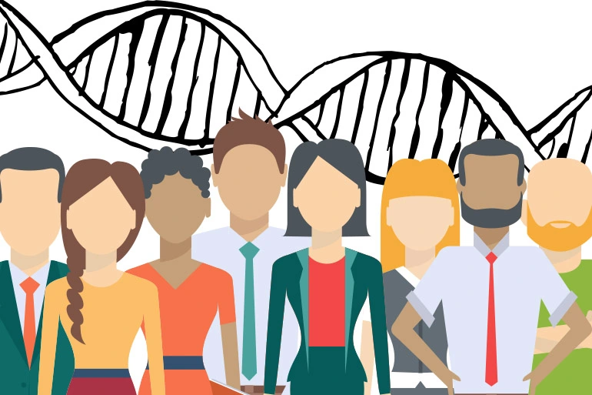
Thank you.

